Slide 1
Estimating genetic diversity and population information from short read (ddRAD-seq) type data
20 June 2022
Chris Barratt (sDiv postdoc)
Laura Mendez (EA PhD student)

Slide 2
Best practice for planning and executing a population genomics project based on ddRAD-seq type data using Stacks 2
We will process raw sequencing reads, run denov—map.pl and then estimate genetic diversity, population structure and evolutionary relationships

Slide 3
Agenda:
Brief introductions and research topics of course leaders and course participants (2-3 mins each)
Short introductory lecture on population genomics and ddRAD-seq and which kinds of questions can be answered with these data (Chris)
Hands on session for each of the major processing steps required for the Stacks 2 pipeline (process_radtags – Chris), denovo_map- Laura). First a submit script 15 min session (Chris)
Hands on session using the populations module of Stacks 2 (populations) to generate suitable output files for downstream analyses (Chris and Laura)
Hands on sessions for estimating genetic diversity, population structure and evolutionary relationships based on output files (Admixture/DAPC (Laura, Chris), RAxML (Chris)
Preconditions:
Participants would ideally need an active UFZ EVE cluster account and basic knowledge on how to use it (though we will briefly go through how to submit jobs etc.). Those without a cluster account can still follow on screen. A basic understanding of sequencing data in general would be beneficial.

Slide 4
This is very much the same as a course we ran in 2019 – the main aim of the course is to get you confident enough to go from raw data to looking at outputs from analyses

Slide 5
What are we doing today?
High-throughput data and ddRAD-seq background – what is it and why use it?
Sampling strategy prior to RAD-seq type work – how should I plan my sequencing?
Bioinformatics to generate output files with a HPC cluster using Stacks2
More specific workshops to follow late 2022 depending on demand (most probably demographic history/local adaptation and Genotype-Environment Association analyses)

Slide 6
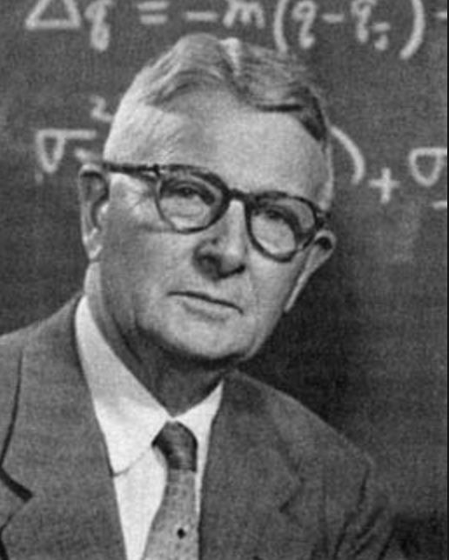
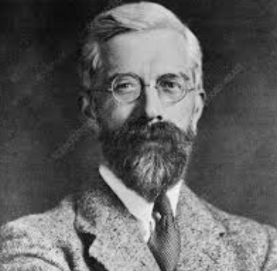
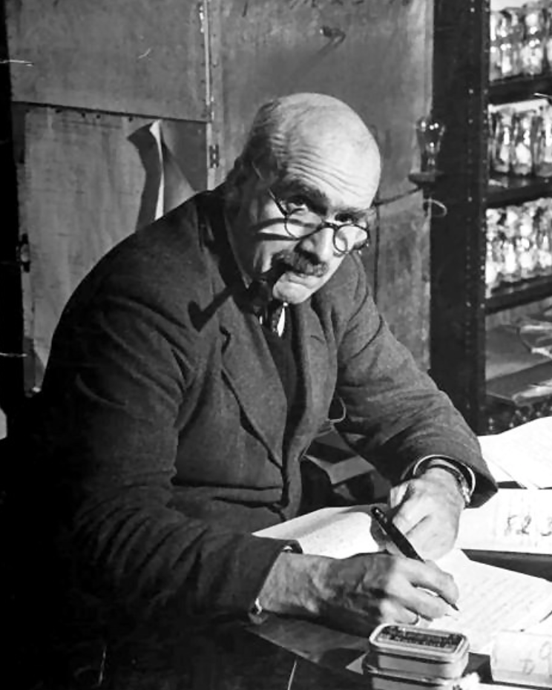
Population Genetics
See Wright, Fisher, Haldane in the early-mid 19th century:
Genetic differentiation within and between populations
Processes leading to diversity patterns
Adaptation/speciation
Markers have gradually become more numerous and associated methods more sophisticated:
- Allozymes - AFLPs - microsatellites - SNPs

Slide 7
High-throughput data
Genetic data (e.g. nuclear loci, mtDNA, chloroplast DNA)
AGCTACGCTACGACTACGATCACTACGACTACGACTACGACTACGATCCGAGAGAGAGAGCGACTCAGACTACCAAC
Genomic data (e.g. WGS, Exon capture, [dd]RAD-seq)
WGS
Exon capture
[dd]RAD-seq
SNP datasets

Slide 8
Restriction site associated DNA sequencing

Slide 9
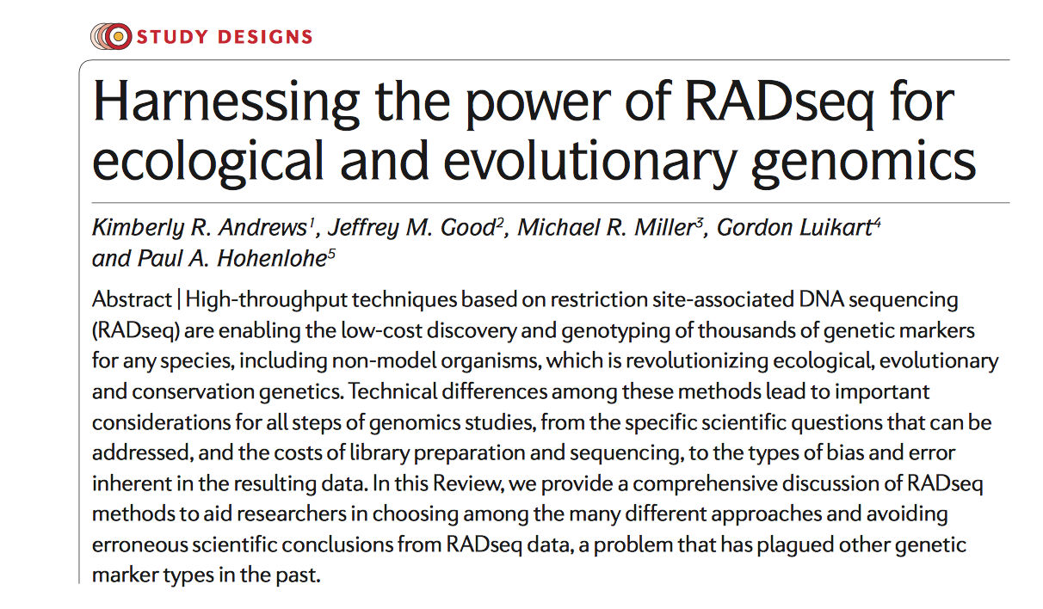
ddRAD-seq
Positives
Large data
Quick data generation
Pooling of individuals
High resolution
Powerful inference
Cost effective
Negatives
Laboratory investment (adapters, equipment such as sonicator or
Pippin prep)
Bioinformatic investment – HPC use,
also learning how to process data

Slide 10
RAD/ddRAD-seq
denovo_map.pl

Slide 11
RAD/ddRAD-seq
Figure 2. Double digest RAD sequencing improves efficiency and robustness while minimizing cost.
(A) Traditional Restriction-Site Associated DNA sequencing (RADseq) uses a single restriction enzyme (RE) digest coupled with secondary random fragmentation and broad size selection to generate reduced representation libraries consisting of all genomic regions adjacent to the RE cut site (red segments). (B) Double digest RAD sequencing (ddRADseq), by contrast, uses a two enzyme double digest followed by precise size selection that excludes regions flanked by either [a] very close or [b] very distant RE recognition sites, recovering a library consisting of only fragments close to the target size (red segments). Representation in this library is expected to be inversely proportional to deviation from the size-selection target, thus read counts across regions are expected to be correlated between individuals (yellow and green bars).

Slide 12
- Conceptualize sequence space… - Number of samples and populations? - Restriction enzyme(s) selected - DNA quality
Sample design
Genome considerations: (you can’t control this…)
- Genome size, GC content? - Repetitive elements? - Ploidy? - Reference genome?
Sampling considerations: (but you can control this…)

Slide 13
Genomic considerations
Smaller is generally better - gives higher coverage of loci as less restriction sites in a smaller genome, so they are sequenced more often per individual
Few repetitive elements (paralogs) better, genome duplications pose additional bioinformatic challenges
Diploid organisms generally easier- most software written to deal with this, though there are workarounds

Slide 14
Sampling design considerations
What are your questions? Pop structure/Phylogeny/Demography – this will dictate how many individuals/populations you need to sequence in your sampling strategy
RAD-seq uses a rare cutter enzyme (e.g. sbfI), ddRAD introduces a frequent cutter too – think about which to use to maximise the information you will get
DNA quality is CRUCIAL! ddRAD in particular needs very high quality DNA, RAD-seq can deal with degraded samples better. You need ACCURATE quantification of ALL samples prior to any labwork. Samples will compete for sequence reads so try to have a working concentration (x ng/ul) across all samples. Run samples on a gel and also use Qubit to measure e.g. 3x and take average

Slide 15
In the laboratory (ca. 1 week for RAD-seq)
Quantify your DNA and samples prior to organising RAD library construction (don’t do all together). Bring 96- plates with your DNA aliquots to lab and do protocols there
Intense concentration needed, but relaxed periods in between (e.g. waiting for PCR / gel steps), so keep alert. One small mistake can ruin hours/days of work!
Be exceptionally consistent and accurate with pipetting especially at the adapter ligation stages – this will determine if individuals are included in your library when pooling. Also be careful with extracting the gel slices, size selection is very important

Slide 16

Sequencing
It’s wise to run samples on a Bioanalyzer to check the size of the fragments in the final library, sequencing facilities can do this but will charge
Once your libaries are done you can store them in the fridge/freezer until ready to take to the sequencing facility
Enjoy that feeling once it’s all done and take a break before…

Slide 17
Bioinformatics
“Bioinformatics” is an extremely broad subject – covers all types of different analyses. For RAD-seq type data the options are usually Stacks, ipyRAD, dDocent, TASSEL, ANGSD to process data
Downstream analyses will typically use output files from these programs but there are numerous conversion tools if needed (Plink, PGDSpider)
Absolutely NOT trivial! You need to become familiar with writing code for linux/unix style environments to do the heavy lifting for you
Also you need to become with High Performance Computing clusters and how to use them as this will be fundamental to parallelising the workload on multiple processors

Slide 18
Bioinformatic workflow using Stacks on a HPC cluster
ddRAD-seq
raw sequence read data
HPC cluster
Stacks 2.61
Perl
Demultiplex
Cluster reads
Build catalogue
Match catalogue
Assemble datasets
Output files for
pop structure, genetic diversity and phylogenetics

Slide 19
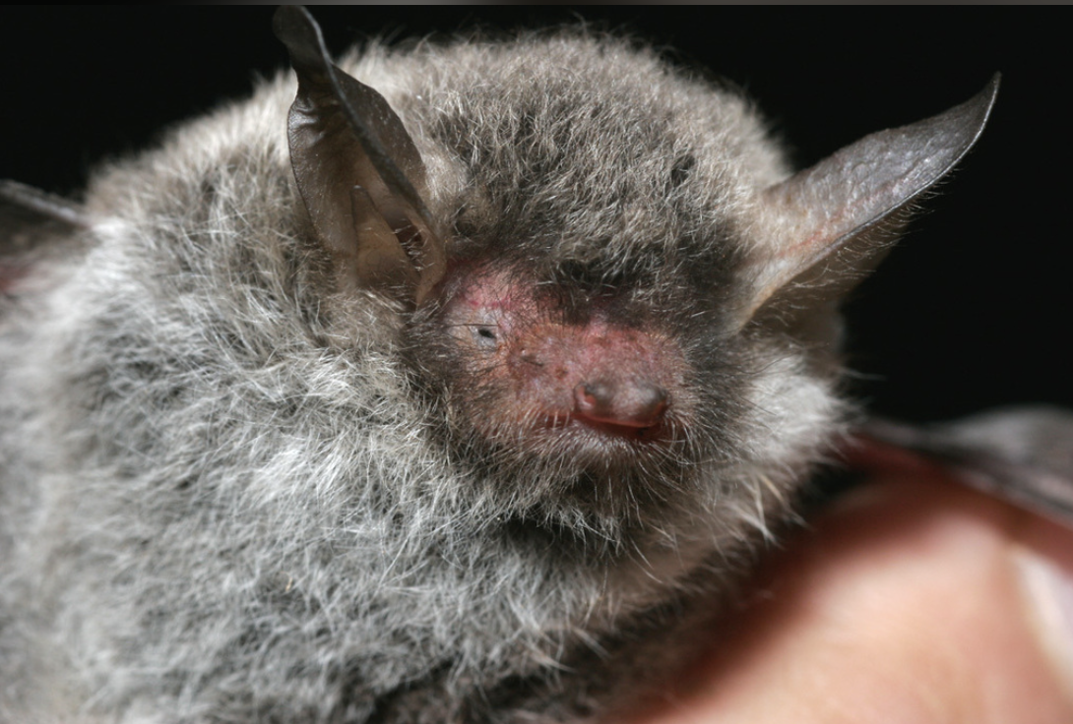
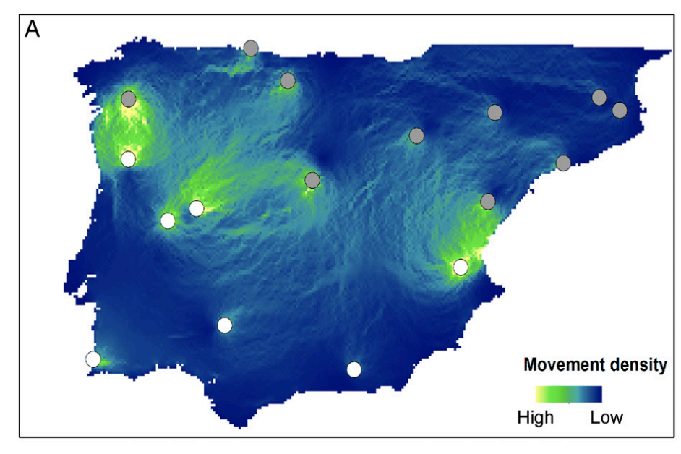
Process_radtags
Myotis escalarai – Escalara’s mouse-eared bat
Subset of 134 samples here (for more manageable processing)

Slide 20
Stacks (http://catchenlab.life.illinois.edu/stacks/)
Programmed and maintained by Julian Catchen
Designed specifically for short read [dd]RAD-seq type data
Written in C++ and Perl
Well established pipeline which has not changed too much, cited many times
Good google user group (very useful!)
Denovo_map.pl, ref_map.pl or modular system (process_radtags, ustacks, cstacks, sstacks, populations) - can rerun any part

Slide 21
Stacks
RAD-seq
raw sequence read data
HPC cluster
Stacks 2.61
Perl
Demultiplex
Cluster reads
Build catalogue
Match catalogue
Assemble datasets
process_radtags
ustacks
cstacks
sstacks
populations
denovo_map.pl
Output files for
pop structure, genetic diversity and phylogenetics

Slide 22
Shell scripts
Shell scripts let you send your jobs to the HPC cluster
Usually one script per individual task, though you can make special scripts which will submit multiple jobs in sequence
I have a main script header which I edit for each individual job:
Job name
Notifications (starts, ends, aborts, pauses etc.) and email address where to send them
Input/Output directories and where to place job logfile
Requirements – processors needed, amount of memory per processor and runtime (used for queueing)
Followed by the main lines of code – load programs and relevant instructions

Slide 23
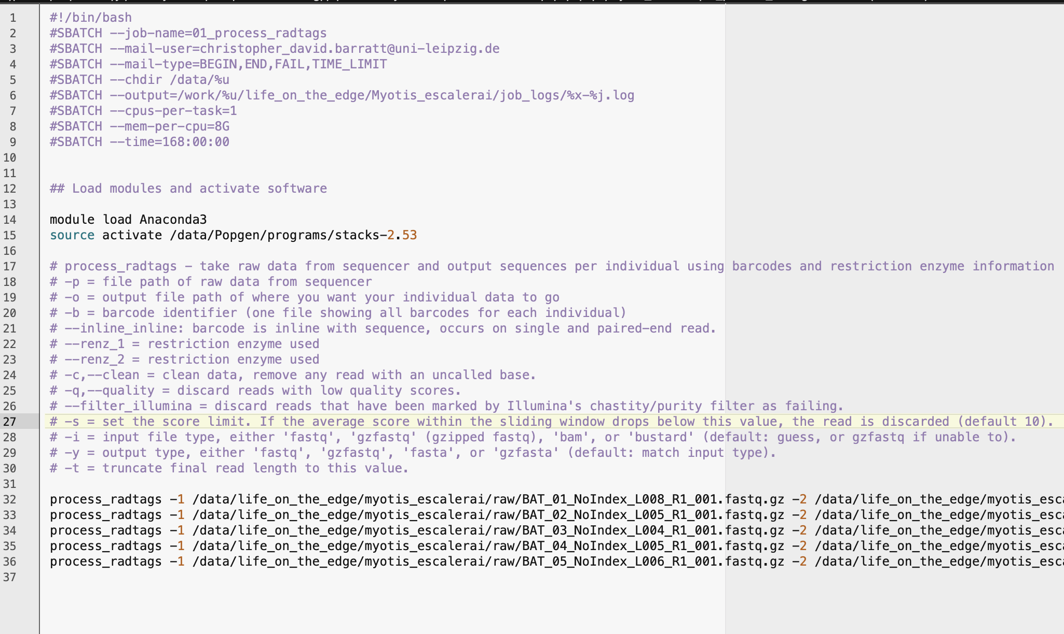
Shell scripts

Slide 24
Example files – 3 download directories + example out
data
(where the raw data is held)
cd /data/idiv_kuehl/
mkdir chris_data
cd chris_data
wget https://www.dropbox.com/s/9snla69bxs9n43m/data.tar.gz
tar –xzf data.tar.gz
rm data.tar.gz
cd ~
mkdir submit_scripts
cd submit_scripts
wget https://www.dropbox.com/s/6pn4brtcdd4jfzj/submit_scripts.tar.gz
tar -xzf submit_scripts.tar.gz
rm submit_scripts.tar.gz
cd /work/barratt
wget https://www.dropbox.com/s/mlaggiw793jxgjz/Stacks.tar.gz
tar –xzf Stacks.tar.gz
rm Stacks.tar.gz
cd /work/barratt
wget https://www.dropbox.com/s/k7r0xufuot3vx6f/Stacks_example_completed.tar.gz
tar –xzf Stacks_example_completed.tar.gz
rm Stacks_example_completed.tar.gz
It’s important to keep these correctly named and in the correct place (you can rename otherwise if you want but you will need to update your scripts to reflect that)
submit_scripts (all scripts to process the data)
Stacks
(output folder)
Stacks_example_completed
(output folder)

Slide 25
[process_radtags demonstration]

Slide 26
Stacks
process_radtags
Demultiplex (all data) – feed in adapter barcodes to get *.fq.gz file per individual (only run once per dataset)
ustacks
Make “stacks” of common sequences in each individual file – this module is run for each individual sample
cstacks
Build catalogue library of all stacks from all individuals (run once per dataset)
sstacks
Match stacks in each individual to the library catalogue – this module is run for each individual sample
Output file generation based on thresholds defined by user and a population map (e.g. only output loci which are present in at least 50% of all samples)
populations
denovo_map

Slide 27
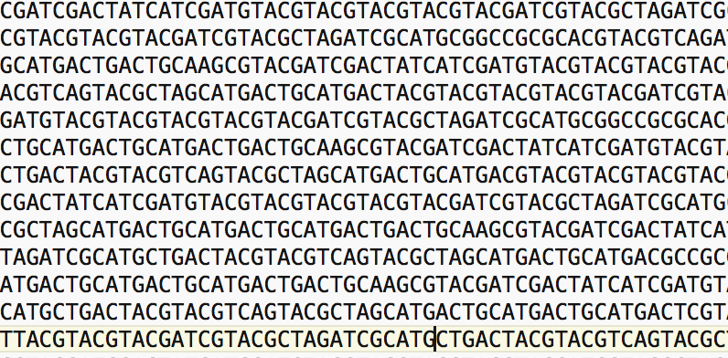
Stacks
process_radtags
Demultiplex (all data) – feed in adapter barcodes to get *.fq.gz file per individual (only run once per dataset)
ustacks
…
cstacks
>40 Gigabytes files with all sequence data! You CANNOT open this in any editor :-0
You need to tell Stacks which sequence belongs to which individual using barcode adapter sequences and restriction enzyme cut sequences
sbatch 1_process_radtags.sh (Chris)
sstacks
populations
denovo_map

Slide 29
Laura…
Denovo_map (assuming demultiplexed files exist)
(just talk through your scripts in the general framework, what they do)
Also the pop maps
I can help you make an Rmd pdf of the code and what the outputs look like

Slide 30
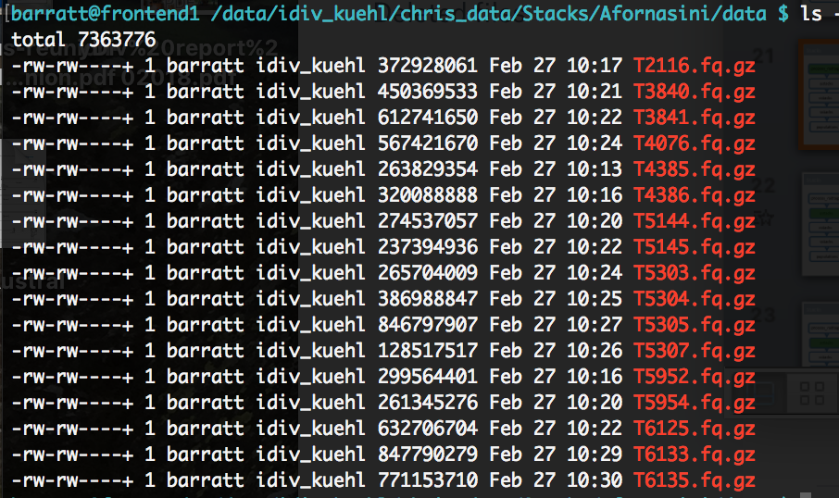
Stacks
process_radtags (done)
Demultiplex (all data) – feed in adapter barcodes to get *.fq.gz file per individual (only run once per dataset)
ustacks
cstacks
sstacks
Output from this process will be nicely demultiplexed data
Sample_1.fq.gz, Sample_2.fq.gz, etc.
populations
denovo_map

Slide 31
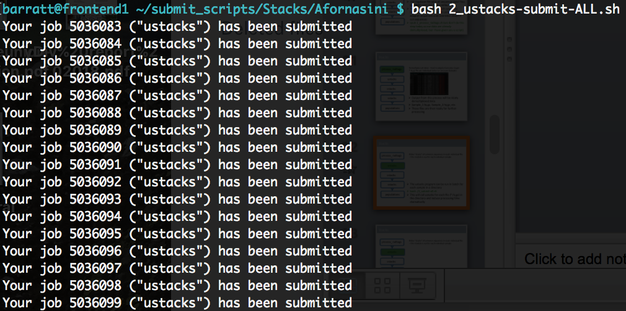
Stacks
process_radtags
Make “stacks” of common sequences in each individual file – this module is run for each individual sample
ustacks
cstacks
sstacks
The ustacks program can be run in batch for each sample in a directory
bash ./2_ustacks-submit-ALL.sh
This will call ustacks for each file (*.fq.gz) in the directory and reduce processing time dramatically
populations

Slide 32
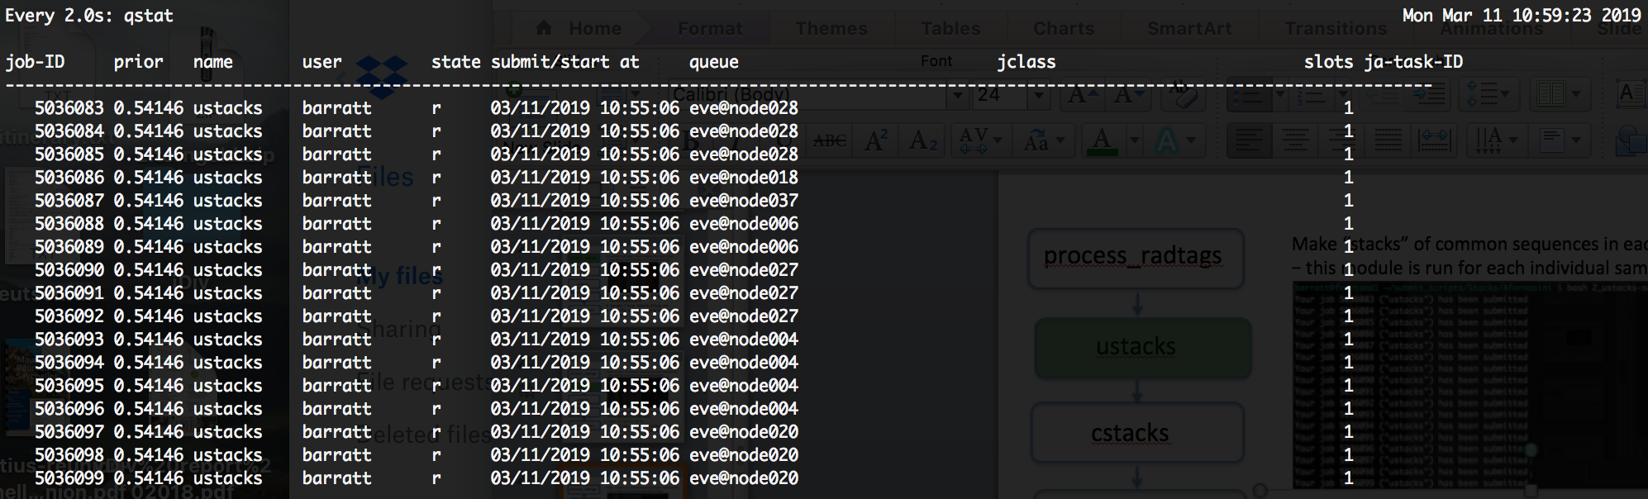
Stacks
process_radtags
Make “stacks” of common sequences in each individual file – this module is run for each individual sample
ustacks
cstacks
sstacks
The ustacks program can be run in batch for each sample in a directory
bash ./2_ustacks-submit-ALL.sh
Keep track of progress with watch qstat
populations

Slide 33
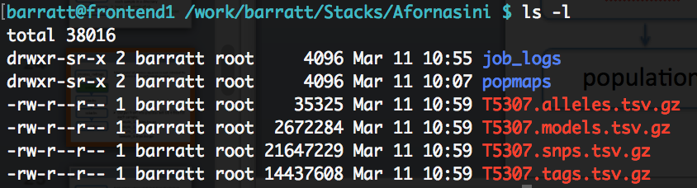
Stacks
process_radtags
Make “stacks” of common sequences in each individual file – this module is run for each individual sample
ustacks
cstacks
sstacks
Output from this process will be 4 files for each individual sample:
Sample_1.alleles.tsv.gz
Sample_1.models.tsv.gz
Sample_1.tags.tsv.gz
Sample_1.snps.tsv.gz
populations

Slide 34
Stacks
process_radtags
Build catalogue library of all stacks from all individuals (run once per dataset)
ustacks
cstacks
sstacks
Now you will build the catalogue library (best to do it from all samples)
qsub 3_cstacks-submit.sh
This will take several hours, and should be done on a single processor core
populations

Slide 35
Stacks
process_radtags
Build catalogue library of all stacks from all individuals (run once per dataset)
ustacks
cstacks
sstacks
Output from this are 3 large files containing all loci from all individuals:
batch_1_alleles.tsv.gz
batch_1_catalog.tsv.gz
batch_1_snps.tsv.gz
populations

Slide 36
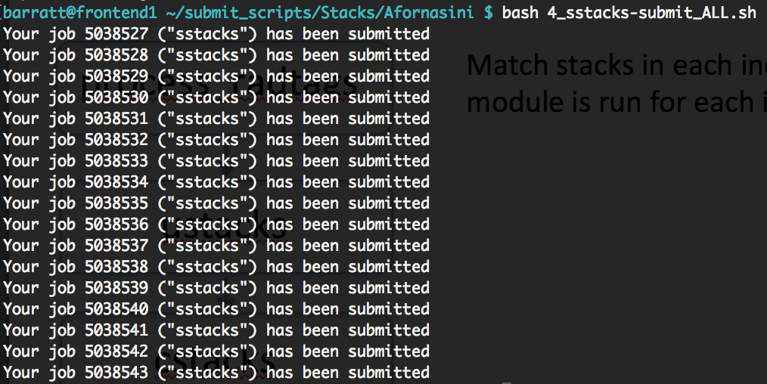
Stacks
process_radtags
Match stacks in each individual to the library catalogue – this module is run for each individual sample
ustacks
cstacks
sstacks
Like ustacks, sstacks can be run in batch for each sample in a directory
bash ./4_sstacks-submit-ALL.sh
This will call sstacks for each file (*.fq.gz) in the directory and match all loci to the catalogue, again reducing processing time
populations

Slide 37
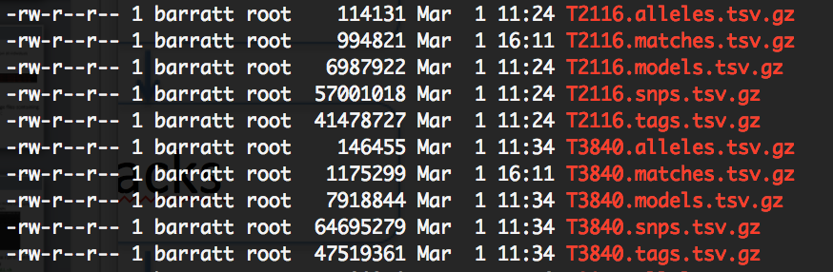
Stacks
process_radtags
Match stacks in each individual to the library catalogue – this module is run for each individual sample
ustacks
cstacks
sstacks
Output from this process is a matches file, so each individual will have a file like this as well as the other 4 files from ustacks:
Sample_1.matches.tsv.gz
populations

Slide 38
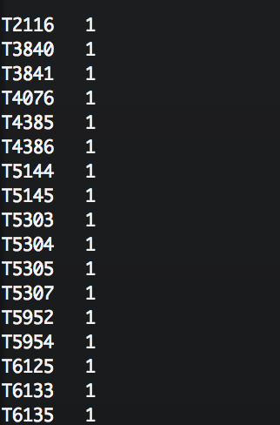
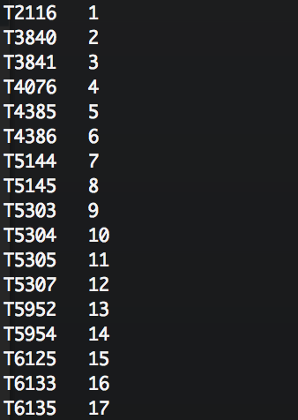
Stacks
process_radtags
Output file generation based on thresholds defined by user (e.g. only output loci which are present in at least 50% of all samples)
ustacks
cstacks
You’re ready to generate your output files!
Here you specify a population map with the samples and their origin. The parameters in the submit script and/or popmap can be adjusted to suit your needs
qsub 5_populations-structure.sh
qsub 5_populations-phylogeny.sh
sstacks
populations

Slide 39
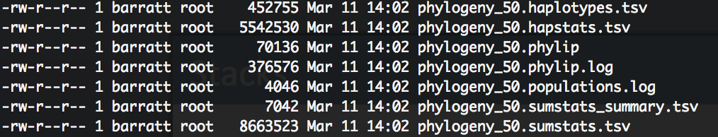
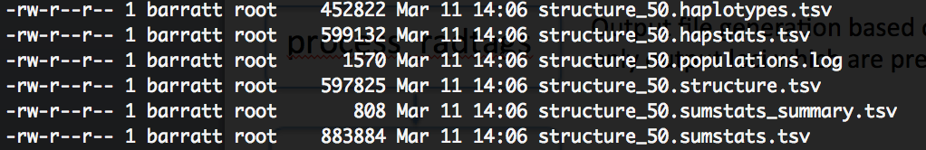
Stacks
process_radtags
Output file generation based on thresholds defined by user (e.g. only output loci which are present in at least 50% of all samples)
ustacks
cstacks
sstacks
And here are your output files
structure_50.structure.tsv – e.g. Structure
phylogeny_50.phylip – e.g. RAxML
The output files you need depends on the analyses you will do, but process is the same
populations

